Slide 1
Paul’s Letters to the
Corinthians

Slide 2
1st CORINTHIANS
Keys to Corinthians

Slide 3
Keys to 1st Corinthians…
Key Words – “Our Lord”
occurs six times in first ten verses
The name “Lord” occurs in many other passages
Key Phrase – “Jesus Christ, and Him crucified”
Key Chapters – Chapter 13 & 15
13- Love the more excellent way
15- Resurrection, Christ’s victory over death

Slide 4
Keys to 1st Corinthians…
Key Verses – Chapter 1:2, 10;
To the church of God that is in Corinth, to those sanctified in Christ Jesus, called to be saints together with all those who in every place call upon the name of our Lord Jesus Christ, both their Lord and ours:
I appeal to you, brothers, by the name of our Lord Jesus Christ, that all of you agree and that there be no divisions among you, but that you be united in the same mind and the same judgment.
Notes:
1Co 1:1-3 -
Paul, called to be an apostle of Jesus Christ. Some of the Judaizing teachers, who had visited the church at Corinth after the departure of Paul, in order to lessen his authority, had asserted that he was not an apostle, divinely called like the Twelve. Hence, at the beginning, he asserts his apostleship, and refers to his divine call. See 1Co_9:1, and 2Co_12:12.
Sosthenes, our brother. A Sosthenes is named in Act_18:17, who was then the chief ruler of the synagogue at Corinth. The Sosthenes whom Paul associated with himself in the letter must have been well known to, and influential among, the Corinthians, and was probably the former chief ruler, who had been converted. Apollos, Priscilla and Aquila, all well known to the church, were at Ephesus with Paul (see chap. 16), but Sosthenes is chosen to appear with him in the salutation.
Unto the church of God. This designation of the church appears oftener than any other in the New Testament.
To them that are sanctified. All of "the church of God at Corinth" were "sanctified in Christ Jesus;" that is, they were set apart from the world and consecrated to God. All Christians are "sanctified" in the sense of the term in the New Testament, and "called to be saints." The humblest Christian is a saint, as well as Peter or Paul.
With all that in every place call, etc. The letter is intended for all Christians, as well as for those at Corinth.
Call upon the name of Jesus Christ. Recognize him as their divine Savior.
Both theirs and ours. The Lord of the saints everywhere as well as ours (1Co_8:6; Eph_4:5). Since there is only one Lord and Master, all Christians should be brethren.
Grace be unto you. The favor of God; the divine blessing. This is the apostolical benediction.
Peace. This is always an appropriate benediction, since peace is one of the greatest blessings, but was especially appropriate to a church which was torn by dissensions.
1:10
Now I beseech you, brethren, etc. How earnest and imploring is the Apostle's exhortation that they should maintain unity!
That ye all speak the same thing. Have no distinctive party declarations. This is violated in the modern sectarian symbols and confessions.
That there be no divisions. "No schisms," in the Greek. If there were none, and all "were perfectly joined together in the same mind and in the same judgment," all would "speak the same thing." There would be no variance in their declarations. It is evident, from what follows, that, while the Corinthians had not separated into various church organizations, they had formed several parties within the church. Organized sects, claiming to be "branches of the church," were unknown till centuries later.

Slide 5
Keys to 1st Corinthians…
THEME…
APPLICATION…
The Lordship of Jesus.
All personal sins and problems in the church are a result of our failure to honor the Christ as Lord of our lives in ALL things.
Respect Christ as Lord…
in the church, in Christian unity, in manner of life, in marriage, in worship, in use of spiritual gifts, in brotherly love, in hope of the resurrection, in faithfulness, in steadfastness, and do all things to the glory of God

Slide 6
Purpose of 1st Corinthians
One of the “salvation” group of epistles.
Includes Romans, 1&2 Corinthians, and Galatians
Subject of group is doctrine of salvation
All written on Paul’s 3rd missionary tour, 57-58 AD
Written because of unfavorable news received by Paul concerning the Corinthian church.
Trouble in the church!

Slide 7
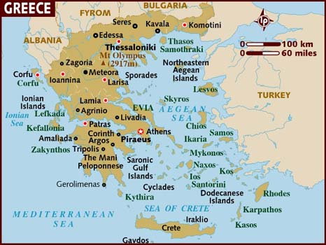
Purpose of 1st Corinthians
The City of Corinth

Slide 8
View of ancient and modern Corinth

Slide 9
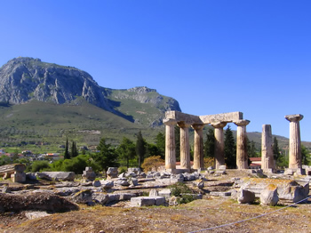
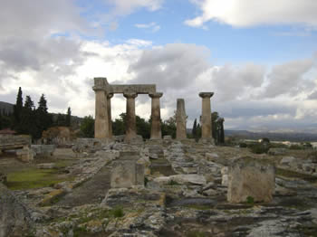
Ruins of the Temple of Apollo in Corinth.

Slide 10
The Temple of Octavia, Augustus' sister.

Slide 11
Ruins of Temple of Aphrodite on Acrocorinth.

Slide 12
Fortress of Acrocorinth at dusk.

Slide 13
Secret passage to the sacred spring.

Slide 14
Moral & Religious Conditions
Famous for its luxury/indulgence
Infamous on account of its immorality
Notorious for its sinfulness
“To live as they live at Corinth” meant a life of lust, lasciviousness, and luxury
Religion and philosophy were degraded to low uses…The city was devoted to the worship of Aphrodite

Slide 16
Problems/Errors in the Corinthian Church
Divisions in the church
Immorality, lack of church discipline and laws concerning marriage
Going to law with one another
Perversion of the Lord’s Supper
Eating of meats offered to idols
Irregularities in public worship
Contention over spiritual gifts
Mistaken view of the resurrection

Slide 17
Messages of 1st Corinthians
The church is in the world but not of the world! (1:2)
Heavenly foolishness is superior to earthly wisdom! (1:17,21 ; 2:1)
Practical Appeal – 1 Cor.15:58

Slide 18
Outline of 1st Corinthians
Intro w/Greeting & Thanksgiving (1:1-9)
The Problem of a Sectarian spirit (1:10-4:21)
The Problem of Incest & Tolerance (5:1-13)
The Problem of Brother Taking Brother to Court before Unbelievers (6:1-11)
The Problem of Fornication (6:12-20)
The Problems of Marriage & Divorce (7:1-40)
The Problems of freedom & Idolatry (8:1-11:1)
The Problem of Head Coverings (11:1-16)
The Problem of Impropriety in taking the Lord’s Supper (11:17-34)
The Problem of Pride & Jealousy in the use of Spiritual Gifts (12:1-14:40)
The Problem of Denial of the Resurrection (15:1-58)
Concluding Remarks (16:1-24)

Slide 19
Paul’s Letters to the
Corinthians

Slide 20
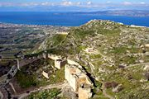
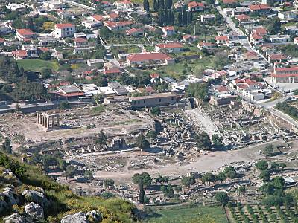
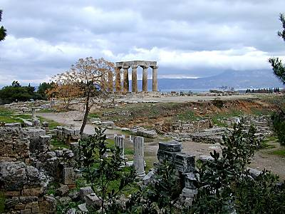

Slide 21
Moral & Religious Conditions
Famous for its luxury/indulgence
Infamous on account of its immorality
Notorious for its sinfulness
“To live as they live at Corinth” meant a life of lust, lasciviousness, and luxury
Religion and philosophy were degraded to low uses…The city was devoted to the worship of Aphrodite

Slide 22
Problems/Errors in the Corinthian Church
Divisions in the church
Immorality, lack of church discipline and laws concerning marriage
Going to law with one another
Perversion of the Lord’s Supper
Eating of meats offered to idols
Irregularities in public worship
Contention over spiritual gifts
Mistaken view of the resurrection

Slide 23
Messages of 1st Corinthians
The church is in the world but not of the world! (1:2)
Heavenly foolishness is superior to earthly wisdom! (1:17,21 ; 2:1)
Practical Appeal… “Therefore, my beloved brothers, be steadfast, immovable, always abounding in the work of the Lord, knowing that in the Lord your labor is not in vain.” 1 Cor.15:58

Slide 24
2nd CORINTHIANS
Keys to Corinthians

Slide 25
Keys to 2 Corinthians…
Key Words – “Comfort & Ministry ”
The nature and source of comfort(1:3-5;2:7;7:6-7,13)
Message and performance of the church’s ministry (3:6,8; 4:1,4-5; 5:18)
Key Phrase – “If any man be in Christ, he is a new creature”
Key Chapter – Chapter 5

Slide 26
Keys to 2 Corinthians…
Key Verses – Chapter 1:3-4 & 4:5-6
Blessed be the God and Father of our Lord Jesus Christ, the Father of mercies and God of all comfort, who comforts us in all our affliction, so that we may be able to comfort those who are in any affliction, with the comfort with which we ourselves are comforted by God.
For what we proclaim is not ourselves, but Jesus Christ as Lord, with ourselves as your servants for Jesus' sake. For God, who said, "Let light shine out of darkness," has shone in our hearts to give the light of the knowledge of the glory of God in the face of Jesus Christ.

Slide 27
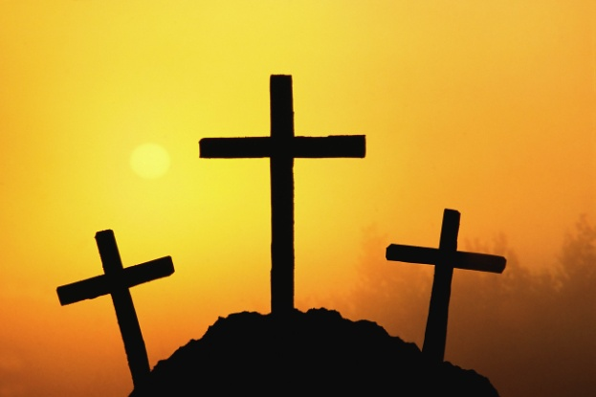
Keys to 2 Corinthians…
THEME…
APPEAL…
ALL Christians are ministers of comfort and of the NT.
Paul defends his apostleship and shows his great faith in God, love for the church and loyalty to Christ.

Slide 28
Purpose of 2Corinthians
“Salvation” epistle.
3rd in the group that deal w/doctrine of salvation
Written in response to Titus’ report of the repentance of Corinth and the changed attitude, Paul opens his heart to this young church.
This letter reveals more about the life and heart of the apostle Paul than any of his other writings.

Slide 29
Purpose of 2Corinthians
Written for the purpose of…
Praising them for obeying the first letter (7:4,15)
To urge them to express their love and encouragement to the repentant brother (2:6-9)
To warn them of false teachers (11:3-4,13)
To defend his apostleship (chpts 11 & 12)

Slide 30
Naturally divided in 3 Parts…
Chapters 1-7
Paul expresses his feelings over the condition of matters in Corinth, his anxiety and relief of Titus’ news
Chapters 8-9
He takes up a great collection from the Gentile churches for the poor at Jerusalem
Chapters 10-13
He repels the insinuations of the Judaizing teachers who were seeking to destroy his influence

Slide 31
Outline of 2 Corinthians
Paul’s Greeting (1:1-2)
Paul’s Explanation of Circumstances (1:3-2:13)
Paul Explains His Ministry (2:14-6:10)
Paul Pleads for Acceptance (6:11-7:4)
Paul’s Comfort and Joy in Titus (7:5-16)
Paul’s Plea for the Poor (8:1-9:15)
Paul’s Defense of Himself (1:1-12:18)
Paul’s Plans for a Third Visit (12:19-13:14)

Slide 32
3 Great Lessons…
Paul’s great faith in God
Paul’s constant love for the church and for the soul’s of men
Paul’s unwavering loyalty to Christ

